Slide 1
MyKoko (Sales) App Improvements
Q1 2020

Slide 2
Pain points
Current Experience
Proposed New Experience
Requirements & User Stories
Questions & Assumptions
Release Plan
Next Steps
Updated Scope

Slide 3

MyKoko App - Pain Points
The MyKoko app is used to sign up new customers, track the progress of existing customers and plays a key role in the sales teams’ day-to-day activities. It therefore plays a crucial role in how quickly the CSRs can grow our customer base, ensure fulfillment of the cookers and follow up with potential customers.
Sales reps find it difficult to manage and track their different customer orders with the myKoko app, because of the structure of their sales lists within the app. For example:
The customer order list has the oldest orders at the top and the newest orders at the bottom of the list. This forces users to scroll to the very bottom of the list to find the most recent orders information.
The customer order list is not segmented into the types of orders they have within their sales pipeline. This makes it difficult for them to focus on a particular category when following up.
MyKoko also has lots of areas that could be tweaked to improve the overall experience for users, both customers and sales reps. For example, navigation, a few UI tweaks, clearer copy, etc.
Find the detailed user research here.

Slide 4
Current Experience
Logs Into Account
Opens Customer Order List
Manually Scrolls to the Bottom
Makes Follow Up Call to Customer
Manually Searches for the right order to follow up with.

Slide 5
New Experience - Options
Option A - Quick Win
Option B - Longer Term (more complex)
User Logs In
CSR Receives Notification
Opens Order
Lists
Views their customer’s activity on various orders
Information
about customer orders
needing follow up
Calls Customer
Calls customer for follow up

Slide 6
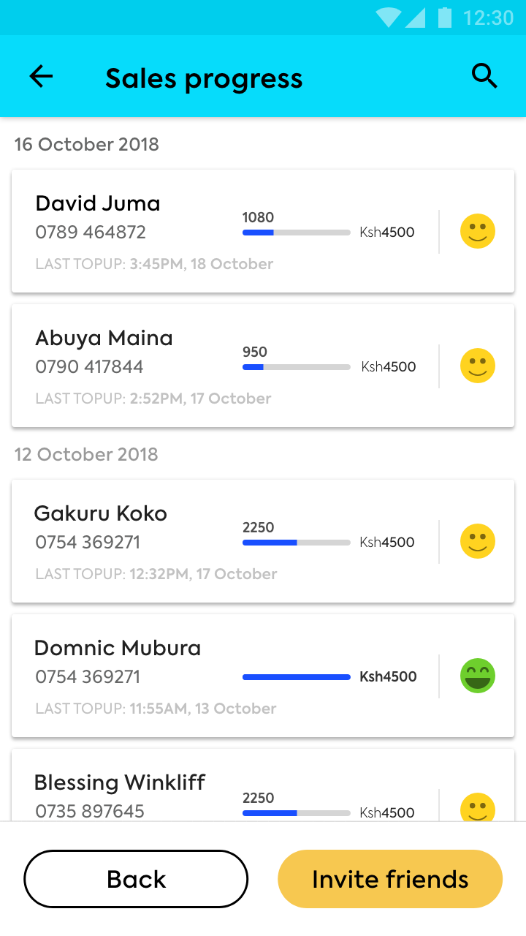
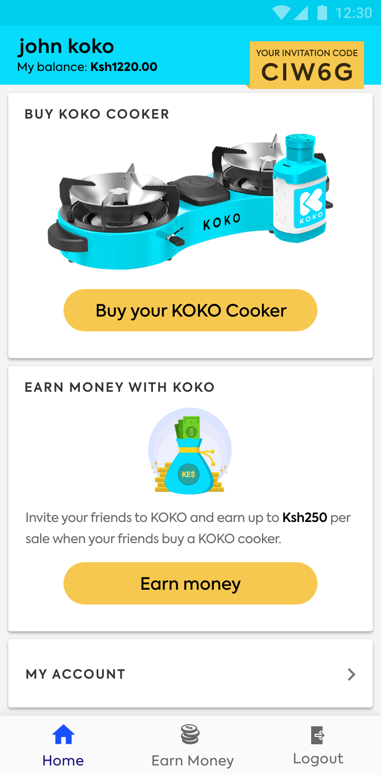
Current Screens
Customer Sales List
Home Screen

Slide 7
Primary Proposed Improvements
Ensuring that the app can be used by CSRs to manage their customer orders would help increase sales. To support this, the main improvements proposed include:
Segment customer orders into specific lists that reflect the sales pipeline:
Leads: New customers that have been signed up but have not saved any money yet
Savings: Customer orders that are being actively topped-up over time (save)
Paid: Customer orders that have been paid for their item in full / have completed saving
Sales: Fulfilled orders
Introduce the ability to filter their customer orders:
Filter by dates
Filter by the type of customer order

Slide 8
Secondary Proposed Improvements
Improving the user experience for both sales and general customers using the app:
Revised navigation within the app from the home page
Revised copy of various CTAs
Updated UI
Increasing logged-in session length

Slide 9
Summary of Scope for Improvements
Overview of the changes proposed are the following:
Scope areas | Changes/Details
Customer Order Segmentation | Separate the types of orders into specific pipeline-based lists Organize customer orders based on recency in customer account activity (most recent at the top of each list) Include the number of orders in each list Update the lists in real-time based on customer account activity
Customer Order Filter | Ability to filter the lists by specific dates Ability to filter the lists by order type
Navigation | Move ‘My Account’ to the bottom navigation bar Include more navigation links on the Home Page
Session Length | Increase session length from 5 seconds to 35 seconds
UI Updates | Home page and Make Money Page UI updates
Copy Changes | Make relevant information clearer

Slide 10
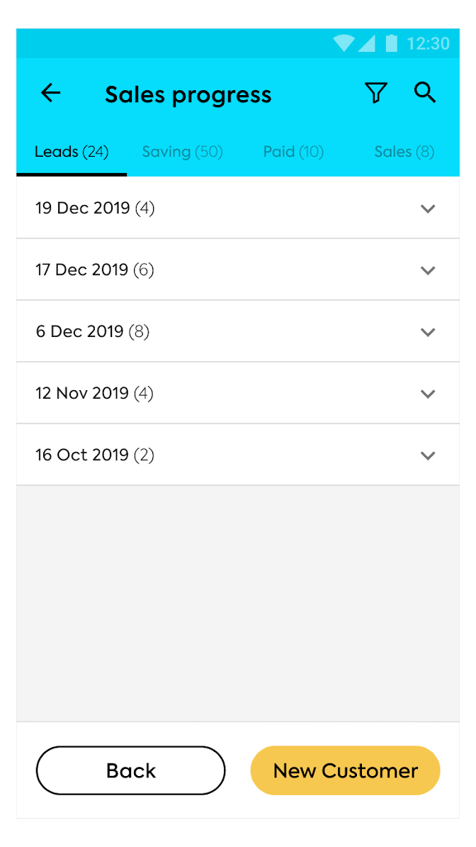
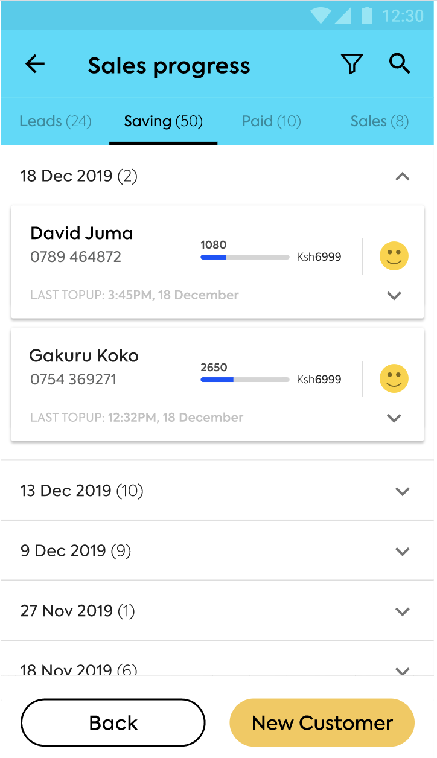
Proposed Designs (Customer Order Segmentation)
Customer Order Lists (segmented)
Users can view the orders in 4 main categories:
Leads: new customers signed up but have not saved
Saving: latest saving top-ups
Paid: latest paid orders (full payment)
Sales: latest sales (fulfillment)
Each Customer Order Lists:
Users can view customer orders under each date:
Ability to collapse and expand the customer orders under each date.
Users can follow up with customers:
Tap on the phone number to open the call feature on their phone
Can also view the details of each customer’s top ups
Notes:
Link to Interactive Designs: Designs

Slide 11
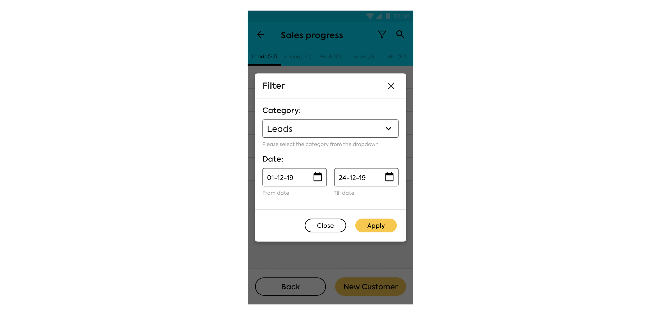
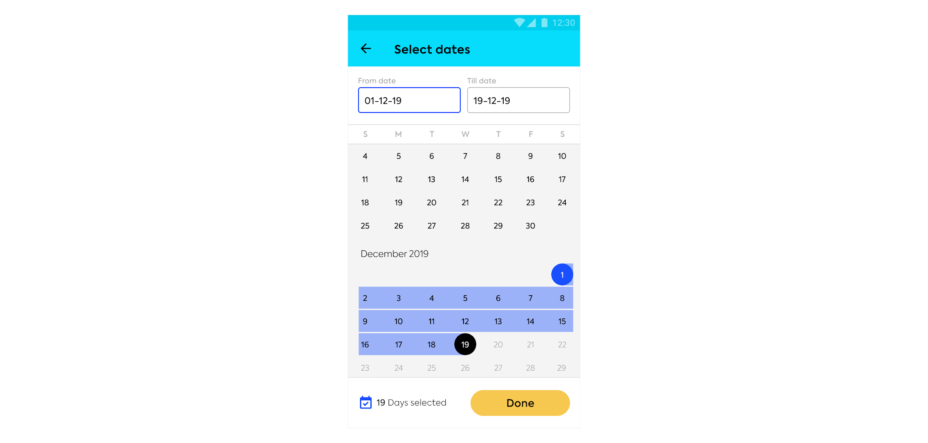
Proposed Designs (Customer Order Filter)
Filter Functionality
Users can filter to view:
The category of the order (lead, saving, paid, etc)
Specific dates/range of dates
Filter Date Picker:
Date ranges will be auto-populated to the last 2 week date range
Tapping on the dates will open a single calendar with the selected date ranges highlighted
The calendar also indicates the number of days selected, eg. 19 days.
Notes:
Link to Interactive Designs: Designs

Slide 12
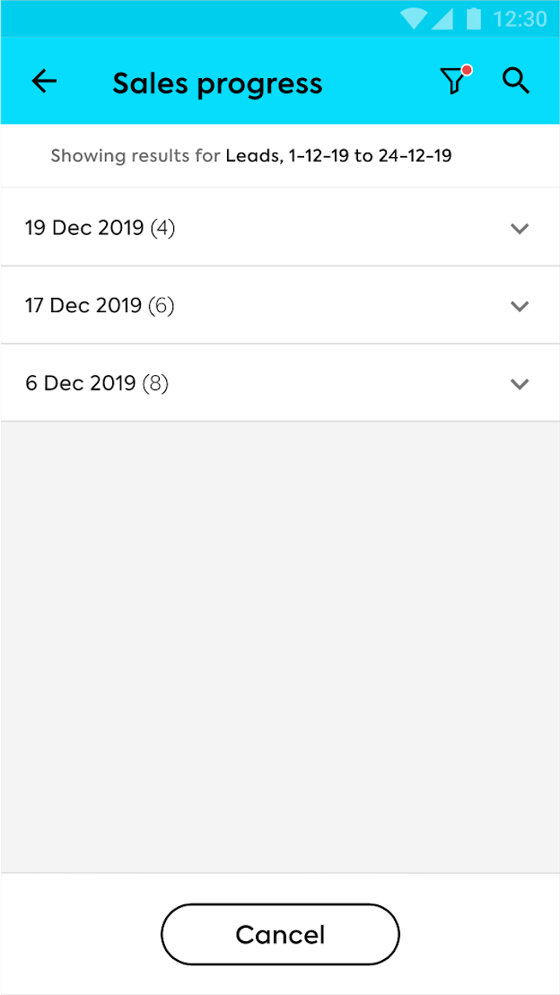
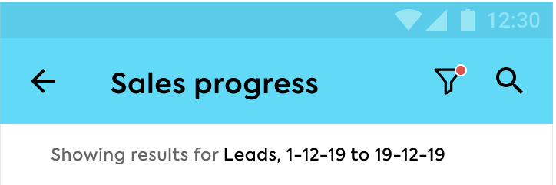
Proposed Designs (Customer Order Filter - Applied)
Applied Filter:
Shows orders within a particular category (leads, saving, etc), within the specified date range.
Similar to the view of orders under the segmented lists, when the filter is applied:
Users can view orders under each date of activity:
Ability to collapse and expand the customer orders under each date.
Users can follow up with customers:
Tap on the phone number to open the call feature on their phone
Can also view the details of each customer’s top ups
Notes:
Link to Interactive Designs: Designs

Slide 13
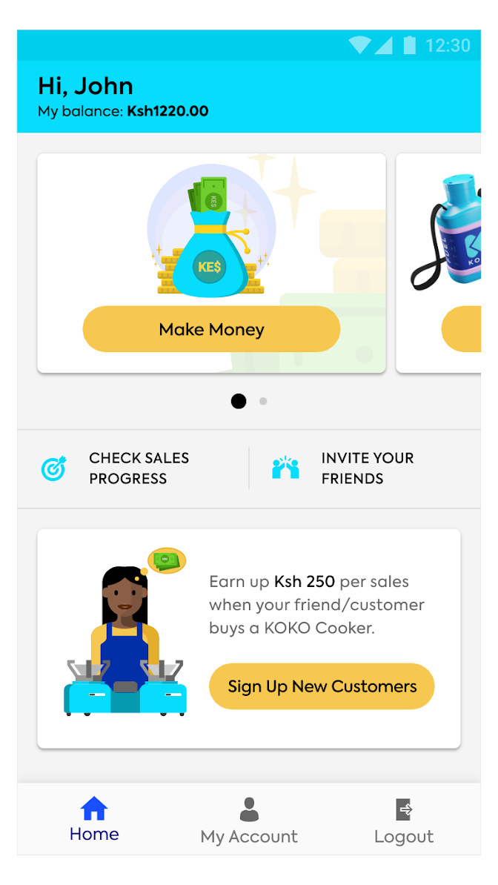
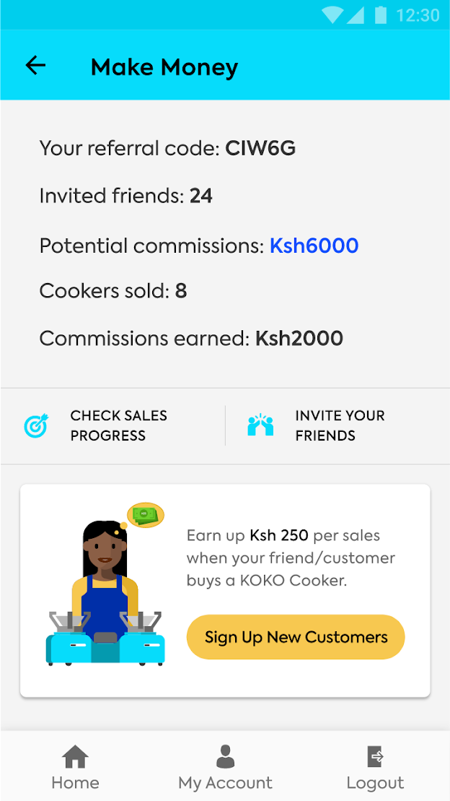
Proposed Designs (Navigation and UI)
Home Screen (centralised)
Users can navigate to key parts of the app from the home screen directly
Make Money Screen (UI updates)
More information on how users can make money, including amounts.
Notes:
Link to Interactive Designs: Designs

Slide 14
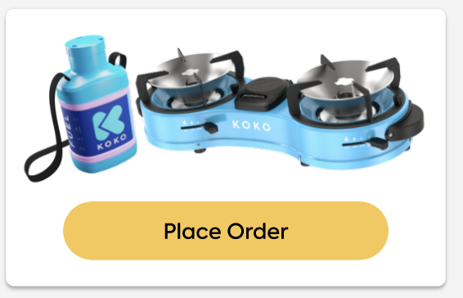
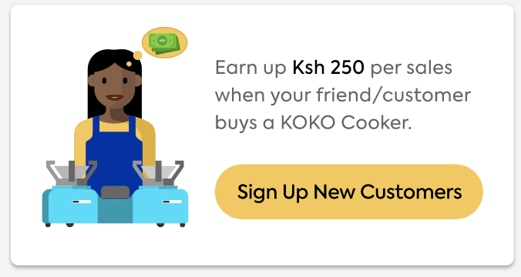
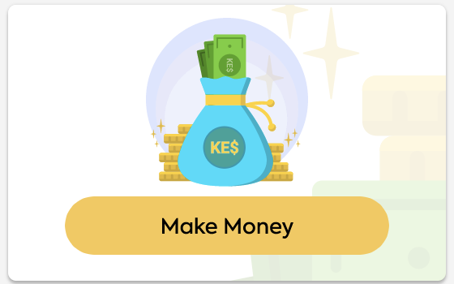
Proposed Designs (Copy Edits)
Home Screen & Make Money Screen
Notes:
Link to Interactive Designs: Designs

Slide 15
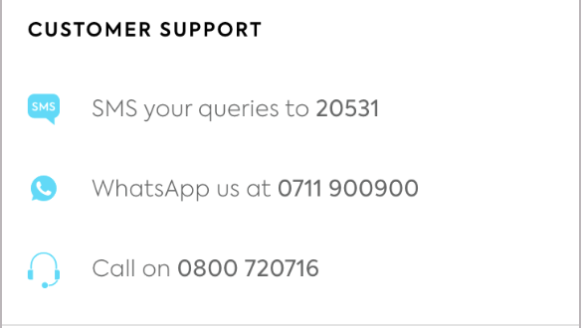
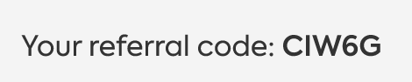
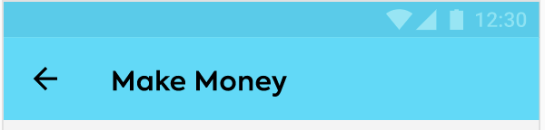
Proposed Designs (Copy Edits)
My Account Screen
Make Money Screen
Notes:
Link to Interactive Designs: Designs

Slide 16
Requirements & Stories
User Stories |  | Simple Fixes
As a user, I want to know where my customers are within the pipeline, so that I can decide when to follow up with them. |  | Increase session length for users to have more time before being logged out of their account
As a user, I want to find important pages easily, so that I can get more done faster. |  | Change copy on certain pages of the app
As a user, I want to manage my customer list, so that I can get a clearer sense of where a customer is within the pipeline. |  | General UI changes on certain pages of the app
As a user, I want to contact KOKO, so that I can get help with an issue.
Details of requirements and user stories on this google sheet

Slide 17
Release Plan
For the sake of agility, the release of these improvements will be split into 2 phases.
Release Plan: 2 Phases
Phase | Release Name | Scope being Released | Beta Testers Release Date | Notes
1 | R30 | Sales Progress Segmentation | 3rd Feb
2 | R32 | Sales Progress Filter Home Screen UI, Make money UI and My Account copy | 20th Feb | Parallel work shared between 2 resources after 10th Feb

Slide 18
Questions & Assumptions
At what point does a customer/lead qualify as an ‘Idle/Dormant’ customer?
Should we add a ‘Leads’ segment? The ones that are being manually written down by CSRs?
How will this affect the ‘search’ functionality? Should the search apply to the selected list?
Can we revisit analytics on the app for better tracking?
How can we reduce the ‘thinking of time’ of CSRs when filtering their lists/looking at their lists?

Slide 19
Next steps
Clarify open questions and potential journeys - done
Discuss priority of different scope elements - done
Prepare final designs - done
Confirm sign off - done
Plan resourcing with Engineering Team - done
Walkthrough engineering team - done
Finalize the Release Plan with engineering - in progress

Slide 20
For more information, contact:
Nyawira Njoroge
n.njoroge@kokonetworks.com

Slide 21
Scope Updates
17th Dec
De-prioritise changes to the ‘Make Money’ Page since the main area for change is the customer sales lists
6th Jan
Exclude fuel tracking as part of scope at this point in time
7th Jan
Include a single calendar with visual confirmation for CSRs to easily select a date range on the filter
Auto-populate the filter dates to a range of the last 2 weeks

Slide 22
Building Updates
6th Feb
Include a ‘Cancelled’ orders list for cancelled orders to move to
10th Feb
Show orders from the last 3 months. Include notification for the user to know about this.
The filter should be applied to the last 6 months only

Slide 23
Beta Testing
Feedback from testing can be found here
Release 1 - Feb 12th 2020
List here
Notes here
Release 2
No Beta Testing necessary

